Slide 1
Working With Files

Slide 2
Understanding File Permission

Slide 3
Reading and Writing Entire Files
To read a file
  First we open the file by fopen(“file_name”,”r”)
  read() the file
  Example:
  $myfile = fopen(“myfile.txt", "r") or die("Unable to open file!");
  echo fread($myfile,filesize(“myfile.txt"));
  fclose($myfile);

Slide 4
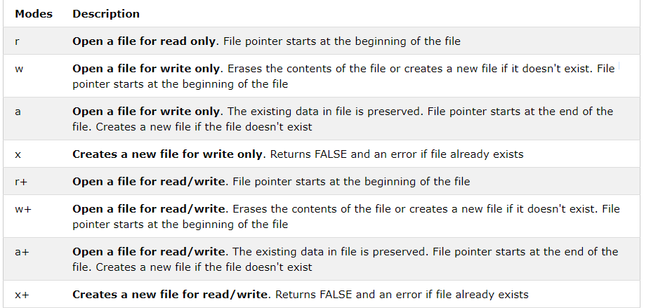
Modes of opening the file
The file may be opened in one of the following modes:

Slide 5
fopen()
fopen(“myfile.txt", "r")
The first parameter of fopen() contains the name of the file to be opened and the second parameter specifies in which mode the file should be opened.

Slide 6
fread()
The fread() function reads from an open file.
The first parameter of fread() contains the name of the file to read from and the second parameter specifies the maximum number of bytes to read.
  fread($myfile,filesize(“myfile"));

Slide 7
fclose()
The fclose() function is used to close an open file.

Slide 8
PHP Create File - fopen()
If you use fopen() on a file that does not exist, it will create it, given that the file is opened for writing (w) or appending (a).

Slide 9
To read a single line we use fgets()
  <?php
  $myfile = fopen(“myfile.txt", "r") or die("Unable to open file!");
  echo fgets($myfile);
  fclose($myfile);
  ?>

Slide 10
To read entire file we use feof
  i.e end of file
  <?php
  $myfile = fopen(“myfile.txt", "r") or die("Unable to open file!");
  // Output one line until end-of-file
  while(!feof($myfile)) {
  echo fgets($myfile) . "<br>";
  }
  fclose($myfile);
  ?>

Slide 11
PHP Read Single Character - fgetc()
<?php
$myfile = fopen(“name.txt", "r") or die("Unable to open file!");
// Output one character until end-of-file
while(!feof($myfile)) {
echo fgetc($myfile);
}
fclose($myfile);
?>

Slide 12
Creating a csv file and reading the data
  <?php
  $name = array (
  array(“Ram", “Thapa" ,“Lalitpur", “Nepal"),
  array(“Will", “Smith", “NW", “USA")
  );
  $file = fopen(“details.csv","w");
  foreach ($name as $nm) {
  fputcsv($file, $nm);
  }
  fclose($file);
  ?>

Slide 13
Reading from csv file
<?php
$file = fopen(“details.csv","r");
$data = fgetcsv($file);
Print_r($data);
//To save in the database insert data as $data[0]
fclose($file);
?>

